Slide 1
Nhi Hin (twitter: @nhihin)
Morgan Newman
Stephen Pederson
Michael Lardelli
Alzheimer’s Disease Genetics Laboratory, The University of Adelaide
facebook.com/forgetfulfish
Bioinformatics Hub, The University of Adelaide
Notes:
Hi everyone. I’m Nhi, a PhD student from the Lardelli lab using zebrafish to investigate familial Alzheimer’s disease. I’m also based in the Bioinformatics Hub so my approach mainly uses statistical techniques to analyse data from our lab.

Slide 2
Summary
Evidence in a mutation model of familial Alzheimer’s disease to support iron deficiency as an early step in disease progression.
Our approach is an extension to standard RNA-seq analysis that assesses iron homeostasis and its disruption in different conditions (e.g. aging, hypoxia).
Nhi Hin^{1,2}, Morgan Newman², Stephen Pederson¹, Michael Lardelli²
1. Bioinformatics Hub, School of Biological Sciences, The University of Adelaide
2. Alzheimer’s Disease Genetics Laboratory, School of Biological Sciences, The University of Adelaide
@nhihin | facebook.com/forgetfulfish
Notes:
Id like to start with the key takeaway messages on this research im about to present. (Read out)
First, we’ve found some early evidence in …
Second, we’d also really like to highlight the fact that our approach is an extension to standard RNA-seq analysis that has the potential to assess iron homeostasis and its disruption in different conditions (e.g. aging, hypoxia).

Slide 3
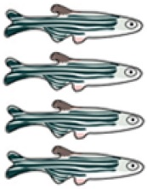
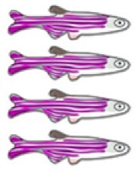
RNA-seq
Samples & Study Design
Hypoxia
Library prep
cDNA from whole brains extracted and prepared for RNA-seq by Morgan.
Hypoxia
24 months
Aging
Normoxia
6 months
Mutation
+/+
psen1 ^{Q96K97/+}
Notes:
So before I go into how we honed in on iron homeostasis, I’d like to introduce the initial aim of this research, which was designed to compare gene expression in the brains of heterozygous mutants & their wild type siblings at a young adult age, and also at an older age when they were infertile. Because aging and hypoxia, or low brain oxygen – are important risk factors in sporadic AD, we also included these conditions to compare their effects on gene expression. As you can see here, we have 8 conditions, with four biological replicates or samples in each.
For RNA-sequencing of these samples, we used whole zebrafish brains.

Slide 4
RNA-seq + data analysis
Expression of ~18,000 genes quantified.
Determined differentially expressed genes with linear modelling + moderated t-test (FDR p < 0.05).
↑253
↓396
↑1386
↑912
Hypoxia
↓1156
↓1362
↑982
↓815
↑271
↑511
↓130
↓247
↑733
Hypoxia
↓468
24 months
Aging
↑958
↑249
↓960
↓296
↑1209
Normoxia
↑1136
↓1020
↓1303
6 months
↑135
↓143
Mutation
+/+
psen1 ^{Q96K97/+}
Law et al. 2014; Ritchie et al. 2015
Notes:
The initial aim of our RNA-sequencing analysis was to get a broad overview of gene expression differences in the brain between these conditions
Out of the 18,000 genes we were able to quantify reliably across all samples, we identified genes which were significantly differentially expressed between conditions.
In particular, tho we were interested in these comparisons between mutant brains and wild type siblings at young and old age. Because the mutation in this study is similar to a familial AD mutation in humans and also in a heterozygous state, we expected gene expression changes we see in the heterozygous mutant brains, particularly at a younger age, to be like clues for the molecular basis of familial AD.

Slide 5
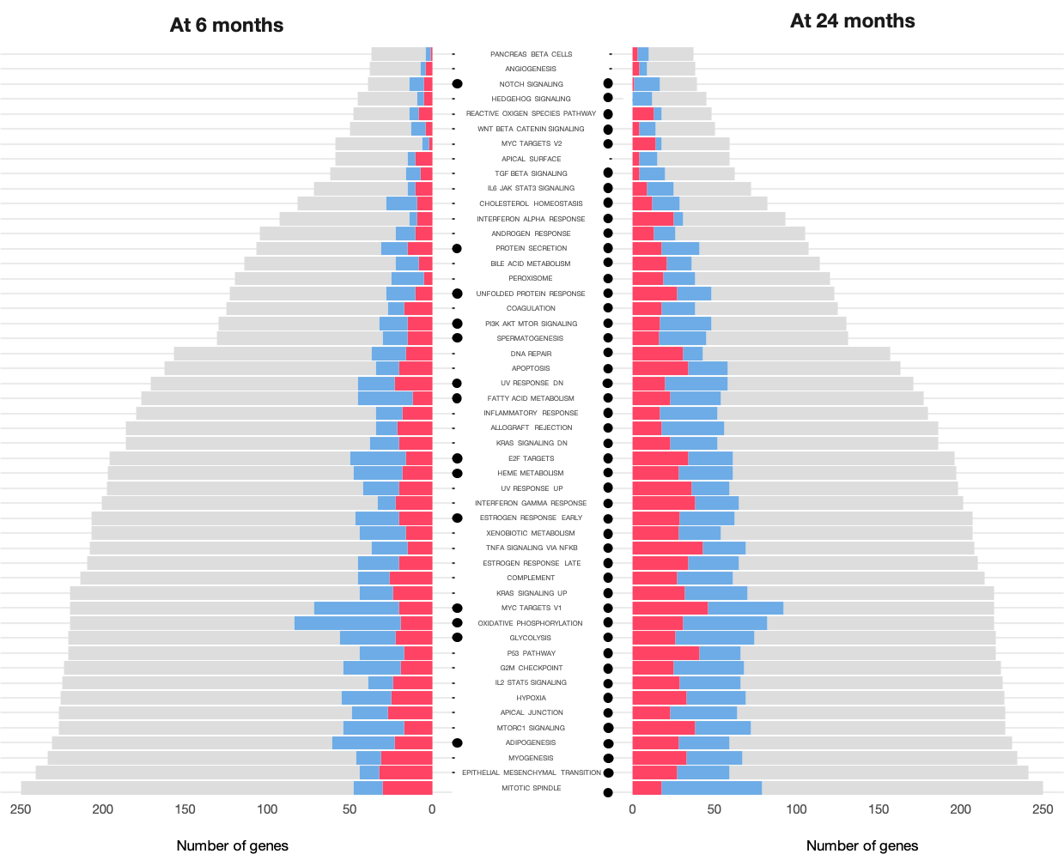
Down
Up
FDR-adjusted p-value from Gene Set Enrichment Analysis with fry, camera, and fgsea < 0.05
Notes:
To interpret these results in a more biologically relevant sense, we used a gene set enrichment analysis. This approach involves testing whether sets of genes involved in the same biological activity are significantly altered in a particular comparison. In the middle here we have the names of the different gene sets, which cover a diverse range of biological activities like (;…). The dots indicate gene sets which were significantly enriched in the comparison between mutant and wts at 6 months on the left and 24 months on right.
Within the gene set, we can also see the proportion of genes which were significantly downregulated or upregulated by these colours here.
I know its a bit small, but what I wanted to point out was that
at an old age, almost every biological pathway shows some alteration, which is supportive of the pathological state in an aged Alzheimer’s disease brain. However, at a younger age as you can see on the left here, fewer pathways are altered, and these are important as they could give us clues as to biological processes which are altered earlier on.

Slide 6
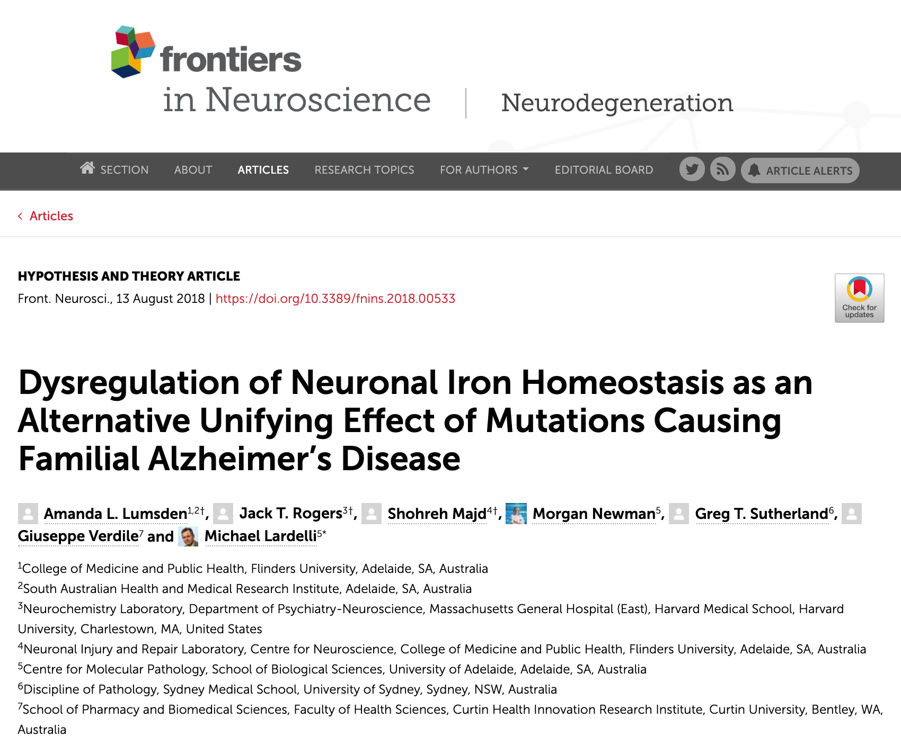
Notes:
I’d like to highlight heme metabolism, as well as ox phos and glycolysis here as pathways which were significantly altered in the young mutant brains relative to wild-type siblings. We can see that early on, there is quite a bit of downregulation with the genes that are part of oxidative phosphorylation, and there is some alteration with glycolysis as well, suggesting some problems with energy metabolism.
(show p-values)
We were interested in exploring these pathways further due to a hypothesis paper published last year which collated evidence from many studies and explored the role of iron homeostasis in familial AD, and its links w hypoxia and energy metabolism, which was particularly relevant to this dataset

Slide 7
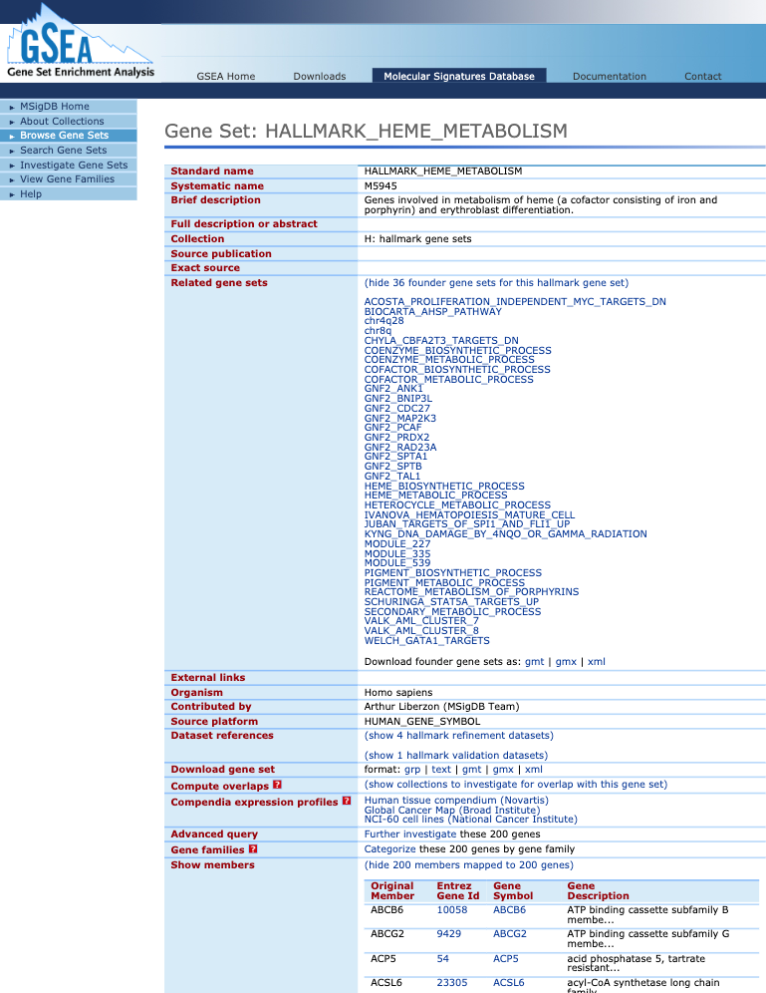
How can we define a comprehensive and sensitive set of genes that we can use to assess iron homeostasis responses and how they differ between conditions?
Hallmark Heme Metabolism
Set of ~200 genes involved in metabolism of heme, based on 36 independently curated gene sets
Iron Responsive Elements (IREs)
Notes:
The Heme Metabolism gene set used in the gene set enrichment analysis is from the Molecular Signatures DB and its a set of ~200 genes involved in metabolism of heme based from results of 36 independent studies.
However, the genes involved are a subset of those in more general iron homeostasis responses – many of the genes in the gene set are specific to biosynthesis of the heme form of iron.
So the question we wanted to ask was whether we could define an improved gene set computationally, that was more sensitive and comprehensive at capturing differences in overall iron homeostasis disruptions under different conditions. For that we turned to Iron Responsive Elements.

Slide 8
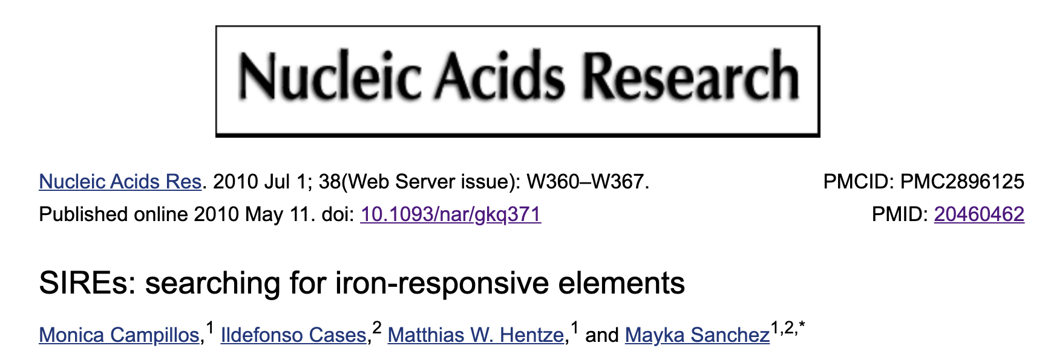
Iron Responsive Elements (IREs)
Hallmark Heme Metabolism
Under iron deficient conditions:
Set of 200 genes involved in metabolism of heme, based on 36 independently curated gene sets
Notes:
This is a bit simplified but in general, under iron deficient conditions, an Iron Responsive Protein, or IRP will bind to Iron Responsive Elements in the5’ or 3’ untranslated regions of genes involved in iron metabolism. Binding to the 5’ end represses translation of the transcript, while binding to the 3’ end stabilises the transcript and increases expression.
Iron responsive elements are IREs are motifs that form a stem loop. When we looked in literature and databases for comprehensive sets of genes w/ IREs, we couldn’t find any so we defined our own computationally. We used the approach in this study, which implemented their methods as a bioinformatic web server.
What we basically did, was extract all 3' and 5' untranslated regions from reference zebrafish transcripts and use this web server to search for sequences able to form IRE stem loop motifs.

Slide 9
393 genes with 5’ IREs
Other gene sets from MSigDB showing overlap with IRE gene sets (enrichment FDR p-value < 0.05)
1,207 genes with 3’ IREs
Hallmark Heme Metabolism
Genes with IREs were identified by searching all reference zebrafish transcripts for IRE stem-loop motifs with SIREs.
Notes:
Using this method, we found 393 genes with Iron responsive elements in the 5' untranslated region
and around 1200 genes with iron responsive elements in the 3' untranslated region
As you can see here, these gene sets are comprehensive and contain many genes which aren't represented in other existing gene sets in databases. While it also has some overlap with the Hallmark heme metabolism, they are also quite distinct. This suggests that the IRE gene sets we defined might be a useful contribution to anyone who wants to look at iron homeostasis in their RNA-sequencing data.

Slide 10
5’IRE
5’IRE
3’IRE
3’IRE
5’IRE
5’IRE
3’IRE
3’IRE
5’IRE
3’IRE
enrichment
p <
-1
-2
-3
10
10
10
Gene Set Enrichment Analysis as previously done, but with the 3’ and 5’ IRE gene sets we defined
Notes:
Weused the 3' and 5' IRE gene sets in another gene set enrichment analysis to see whether these genes might be expressed more actively in particular conditions.
We find that aging seems to involve enrichment of 3' IRE genes, while hypoxia, or low oxygen seems to involve a more extreme iron homeostasis response that involves enrichment of both.

Slide 11
5’IRE
3’IRE
5’IRE
3’IRE
enrichment
p <
-1
-2
-3
10
10
10
Gene Set Enrichment Analysis as previously done, but with the 3’ and 5’ IRE gene sets we defined
Notes:
Importantly, we find that in the comparison of mutant and wild-type, there is enrichment in the 3' IRE genes, particularly at a younger age, and this response seems to be similar to the 3' IRE gene expression changes happening under hypoxia.
Unfortunately I don't have enough time to go more into detail about how they are similar, but we’ve done some additional analyses that show that the same genes are being expressed in similar ways in these comparisons.

Slide 12
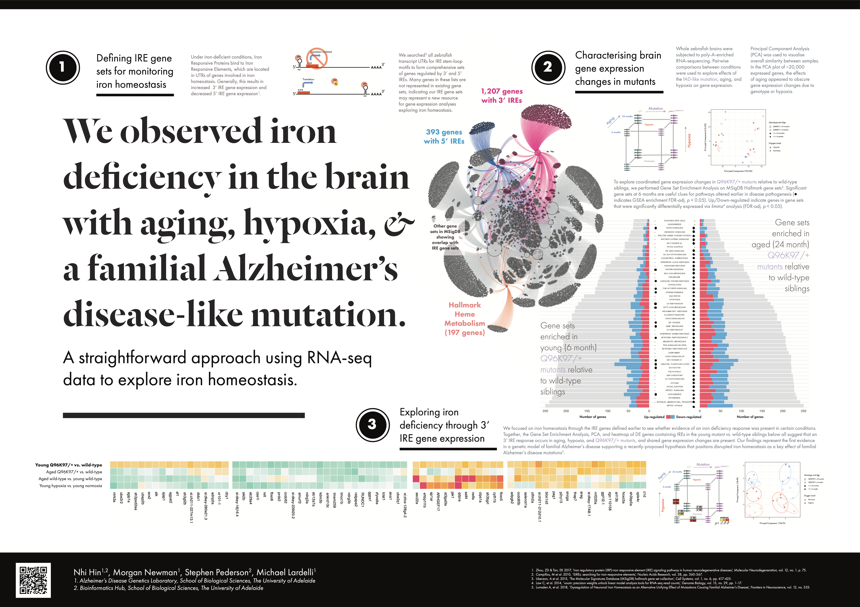
Notes:
For anyone here is coming to AAIC I expand a bit on these additional analyses in my poster ☺

Slide 13
Acknowledgements
Michael Lardelli Stephen Pederson
Alzheimer’s Disease Genetics Laboratory Bioinformatics Hub
Morgan Newman
Karissa Barthelson
Yang Dong
Lachlan Baer
Jiayu Ruan
Ewen Gerken
Aoya Chen
Syahida Ahmed
Tanya Jayne
Jimmy Breen
Rick Tearle
Nathan Watson-Haigh
Mark Armstrong
Dan Kortschak
Lachlan Baer
Alastair Ludington
Charlotte Sai
Melanie Smith
Ning Liu
Justin Bogias
Jacqui Rehn
+ Dave Adelson
Notes:
I would like to thank my supervisors and the rest of the lab for supporting my research.
Thank you very much for listening!

Slide 14
Increased expression in young mutants only
Young Q96K97/+ vs. wild type
Aged Q96K97/+ vs. wild type
Aged wild type vs. young wild type
Young hypoxia vs. normoxia
sox2
alk
ajap1
sf1
dido1
cby1
ap1ar
jak1
qdpra
sall4
nelfa
fbxo5
pag1
sncga
thap7
areg
c1d
ntrk3a
sgip1a
agpat2
ctps1a
cyth1b
p2ry13
arl13b
cplx4c
ube2r2
ubap2b
sh3gl2b
adnp2a
sec22a
st3gal3a
sh3bgrl
olfm2a
bloc1s3
rnf220a
ggt1l2.1
hoxc3a
lrrfip1b
or101-1
ehbp1l1b
ccdc85b
sh3bp5a
sh3pxd2aa
ARHGEF17
selenot1a
zgc:110158
si:dkey-280e21.3
si:dkey-174i8.1
si:ch211-227m13.1
si:ch211-212d10.1
DE genes with 3’ IREs in the young Q96K97/+ vs. wild type comparison
Notes:
Group 1
May represent the “early response” in the mutants.
These genes are up only in young mutants, but do not go up with normal aging or hypoxia, indicating that they are specific to the mutation.
Group 2
These are genes that show decreased expression in aging, hypoxic response, and also in the mutants as well (relative to age matched siblings).
Group 3
These genes tend to show increased expression in aging, hypoxic response, and also in mutants. May be slightly weaker in the 24 month old mutants but overall quite similar between the comparisons shown.
Group 4
This small group of genes shows consistent decreased expression in mutants but mixed patterns during aging or hypoxia.
May represent mutant-specific genes.
Group 5
Increased expression in young mutants. Some are also increased under aging, hypoxic response, or in the aged mutants, to differing extents.

Slide 15
Also increased during aging and hypoxia
Young Q96K97/+ vs. wild type
Aged Q96K97/+ vs. wild type
Aged wild type vs. young wild type
Young hypoxia vs. normoxia
sox2
alk
ajap1
sf1
dido1
cby1
ap1ar
jak1
qdpra
sall4
nelfa
fbxo5
pag1
sncga
thap7
areg
c1d
ntrk3a
sgip1a
agpat2
ctps1a
cyth1b
p2ry13
arl13b
cplx4c
ube2r2
ubap2b
sh3gl2b
adnp2a
sec22a
st3gal3a
sh3bgrl
olfm2a
bloc1s3
rnf220a
ggt1l2.1
hoxc3a
lrrfip1b
or101-1
ehbp1l1b
ccdc85b
sh3bp5a
sh3pxd2aa
ARHGEF17
selenot1a
zgc:110158
si:dkey-280e21.3
si:dkey-174i8.1
si:ch211-227m13.1
si:ch211-212d10.1
DE genes with 3’ IREs in the young Q96K97/+ vs. wild type comparison
Notes:
Group 1
May represent the “early response” in the mutants.
These genes are up only in young mutants, but do not go up with normal aging or hypoxia, indicating that they are specific to the mutation.
Group 2
These are genes that show decreased expression in aging, hypoxic response, and also in the mutants as well (relative to age matched siblings).
Group 3
These genes tend to show increased expression in aging, hypoxic response, and also in mutants. May be slightly weaker in the 24 month old mutants but overall quite similar between the comparisons shown.
Group 4
This small group of genes shows consistent decreased expression in mutants but mixed patterns during aging or hypoxia.
May represent mutant-specific genes.
Group 5
Increased expression in young mutants. Some are also increased under aging, hypoxic response, or in the aged mutants, to differing extents.

